Slide 1
Simple Data Types

Slide 2
Numbers & Strings
Students should open code.pyret.org (CPO) in their browser, and click "Sign In".
This will ask them to log in with a valid Google account (Gmail, Google Classroom, YouTube, etc.), and then show them the "Programs" page. This page is empty - they don’t have any programs yet!
Have them click "Open Editor".

Slide 3
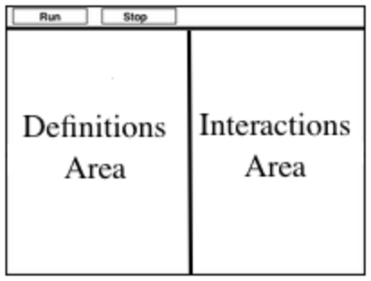
Numbers & Strings
The Editor you just logged into should have looked something like the diagram you see here. There are a few buttons at the top, but most of the screen is taken up by two large boxes.
The Definitions Area on the left is where programmers define values and functions that they want to keep.
The Interactions Area on the right allows them to experiment with those values and functions.
For now, we will only be writing programs in the Interactions Area.

Slide 4
Numbers & Strings
Math is a language, just like English, Spanish, or any other language. Languages have nouns (e.g. “ball”, “tomato”, etc.) and verbs, which are actions we can perform on these nouns (e.g. - I can “throw a ball”). Math and programming also have values, like the numbers 1, 2 and 3. And, instead of verbs, they have functions, which are actions we can perform on values (e.g. - “I can square a number”).

Slide 5
Numbers & Strings
Languages also have rules for syntax. In English, for example, words don’t have ! and ? in the middle. In math and programming numbers don’t have & in them.
Languages also have rules for grammar. The cat sat. is a sentence, whereas The sat cat. is nonsense, even though all the words are valid syntax. The order of the words matters!
Keeping the importance of syntax and grammar in mind is helpful when learning to program!

Slide 6

Numbers & Strings
With your partner(s), turn to Numbers & Strings in your workbooks, and follow the instructions there.
Pay special attention to the error messages.

Slide 7
Numbers & Strings
What did you notice?
What did you wonder?
Did you get any error messages?

Slide 8
Numbers & Strings
Numbers and Strings evaluate to themselves.
Anything in quotes is a String, even something like "42".
Strings must have quotation marks on both sides.
Operators like +, -, *, and / need spaces around them.
If more than one operator is used, we need parentheses
We can add two Numbers or two Strings to one another, but we can’t add the Number 4 to the String "hello".

Slide 9
Booleans
What’s the answer…
Is 3 greater than 10?

Slide 10
Booleans
Boolean-producing expressions are yes-or-no questions and will always evaluate to either true (“yes”) or false (“no”). The ability to separate inputs into two categories is unique and quite useful!

Slide 11
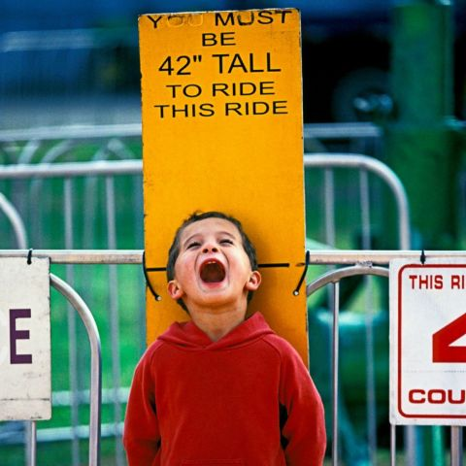
Booleans
For example, some roller coasters with loops require passengers to be a minimum height to make sure that riders are safely held in place by the one-size-fits all harnesses. The gatekeeper doesn’t care exactly how tall you are, they just check whether you are as tall as the mark on the pole. If you are, you can ride, but they don’t let people on the ride who are shorter than the mark because they can’t keep them safe.

Slide 12
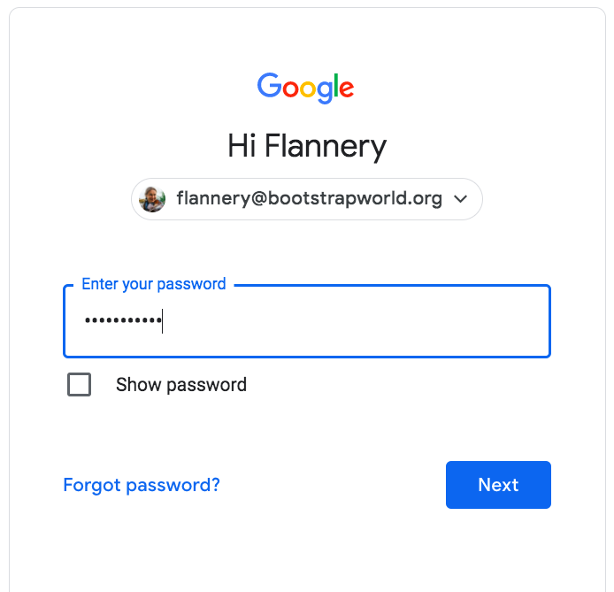
Booleans
Similarly, when you log into your email, the computer asks for your password and checks whether it matches what’s on file. If the match is true it takes you to your messages, but, if what you enter doesn’t match, you get an error message instead.

Slide 13
Booleans
Brainstorm other scenarios where Booleans are useful in and out of the programming environment.
Notes:
Rock concerts check whether you have VIP passes.
Bars check whether you’re 12.
Hotel elevators check whether your room is on the floor you’re trying to go to.
Subways check whether you have sufficient funds.
ATMs check your pins.

Slide 14
Booleans
Turn to Booleans. With your partner, make predictions about what each expression will return and then test them out in the editor.

Slide 15
Booleans
What sets Booleans apart from other data types?
Why do you think <> was selected to represent not equal?
Any questions about what any of the other Boolean operators do?

